Slide 1
Introduction To Compiler
Course Code: CSC 3220
Course Title: Compiler Design
Dept. of Computer Science
Faculty of Science and Technology
Lecture No: | 3 | Week No: | 2 | Semester: | Summer
Lecturer: | Atkia Akila karim

Slide 2
Lecture Outline
Linker and Loader
Front end and Back end of a compiler
Symbol Table Management
Error Handler

Slide 3
Objectives and Outcomes
Objectives:
Understand the Structure of a compiler
Understand the tools involved( Scanner generator, Parser generator, etc)
Outcome:
Students will be able to represent the simulation of all phases of a compiler for inputs.

Slide 4
Linker and Loader
Linker: A linker, also called link editor or binder, is a program that combines the object modules to form an executable program. In general , in case of a large program, programmers prefer to break the code in to smaller modules, as this simplifies the programming task. Eventually, when the source code of all the modules has been converted in to object code, all the modules need to be put together, which is done by the linker

Slide 5
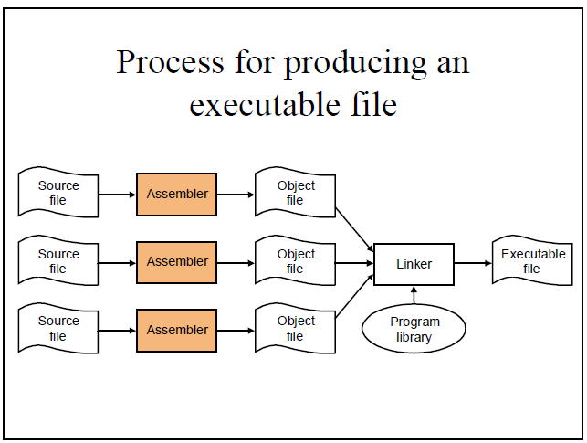

Slide 6
Loader
A loader is a special type of a program that copies programs from a storage device to the main memory, where they can be executed.

Slide 7
Front end and Back end of a Compiler
Front end:
Lexical Analyzer
Syntax Analyzer
Semantic Analyzer
Intermediate Code Generator
Back end :
V. Code Optimizer
VI. Code Generator

Slide 8
Advantages of Using Front-end and Back- end
Retargeting: Build a compiler for a new machine by attaching a new code generator to an existing front-end
Optimization: Reuse intermediate code optimizers in compilers for different languages and different machines.

Slide 9
Symbol Table Management
A symbol table is a data structure containing all the identifiers (i.e. names of variables, procedures etc.) of a source program together with all the attributes of each identifier.
For variables, typical attributes include:
its type,
how much memory it occupies,
its scope.
For procedures and functions, typical attributes include:
the number and type of each argument (if any),
the method of passing each argument, and
the type of value returned (if any).

Slide 10
Symbol Table Management
The purpose of the symbol table is to provide quick and uniform access to identifier attributes throughout the compilation process. Information is usually put into the symbol table throughout the analysis phase and used for the synthesis phase.

Slide 11
Error Handler
Each of the six phases (but mainly the analysis phases) of a compiler can encounter errors. On detecting an error the compiler must:
report the error in a helpful way,
correct the error if possible, and
continue processing (if possible) after the error to look for further errors.

Slide 12
Lecture References
A. Aho, R. Sethi and J. Ullman, Compilers: Principles, Techniques and Tools
(The Dragon Book), [ Second Edition]

Slide 13
References
A. Aho, R. Sethi and J. Ullman, Compilers: Principles, Techniques and Tools(The Dragon Book), [ Second Edition]
Principles of Compiler Design (2nd Revised Edition 2009) A. A. Puntambekar
Basics of Compiler Design Torben Mogensen

